Slide 1
CHAPTER 22
Transaction Management

Slide 2
Chapter 22 - Objectives
Function and importance of transactions.
Properties of transactions.
Concurrency Control
Meaning of serializability.
How locking can ensure serializability.
Deadlock and how it can be resolved.
How timestamping can ensure serializability.
‹#›

Slide 3
Concurrency Control Techniques
‹#›

Slide 4
Concurrency Control Techniques
Two basic concurrency control techniques:
Locking,
Timestamping.
Both are conservative approaches: delay transactions in case they conflict with other transactions.
‹#›

Slide 5
Concurrency Control Techniques
1- Locking
‹#›

Slide 6
Locking
Transaction uses locks to deny access to other transactions and so prevent incorrect updates.
Most widely used approach to ensure serializability.
Two types of locks:
shared (read) lock - prevents transactions from modifying the resource
exclusive (write) lock - prevents another transaction from modifying this resource or even reading it.
‹#›

Slide 7
Locking - Basic Rules
A transaction with shared lock on item, can read but not update item.
A transaction with exclusive lock on item, can both read and update item.
Reads cannot conflict, so more than one transaction can hold shared locks simultaneously on same item.
Exclusive lock gives transaction exclusive access to that item.
‹#›

Slide 8
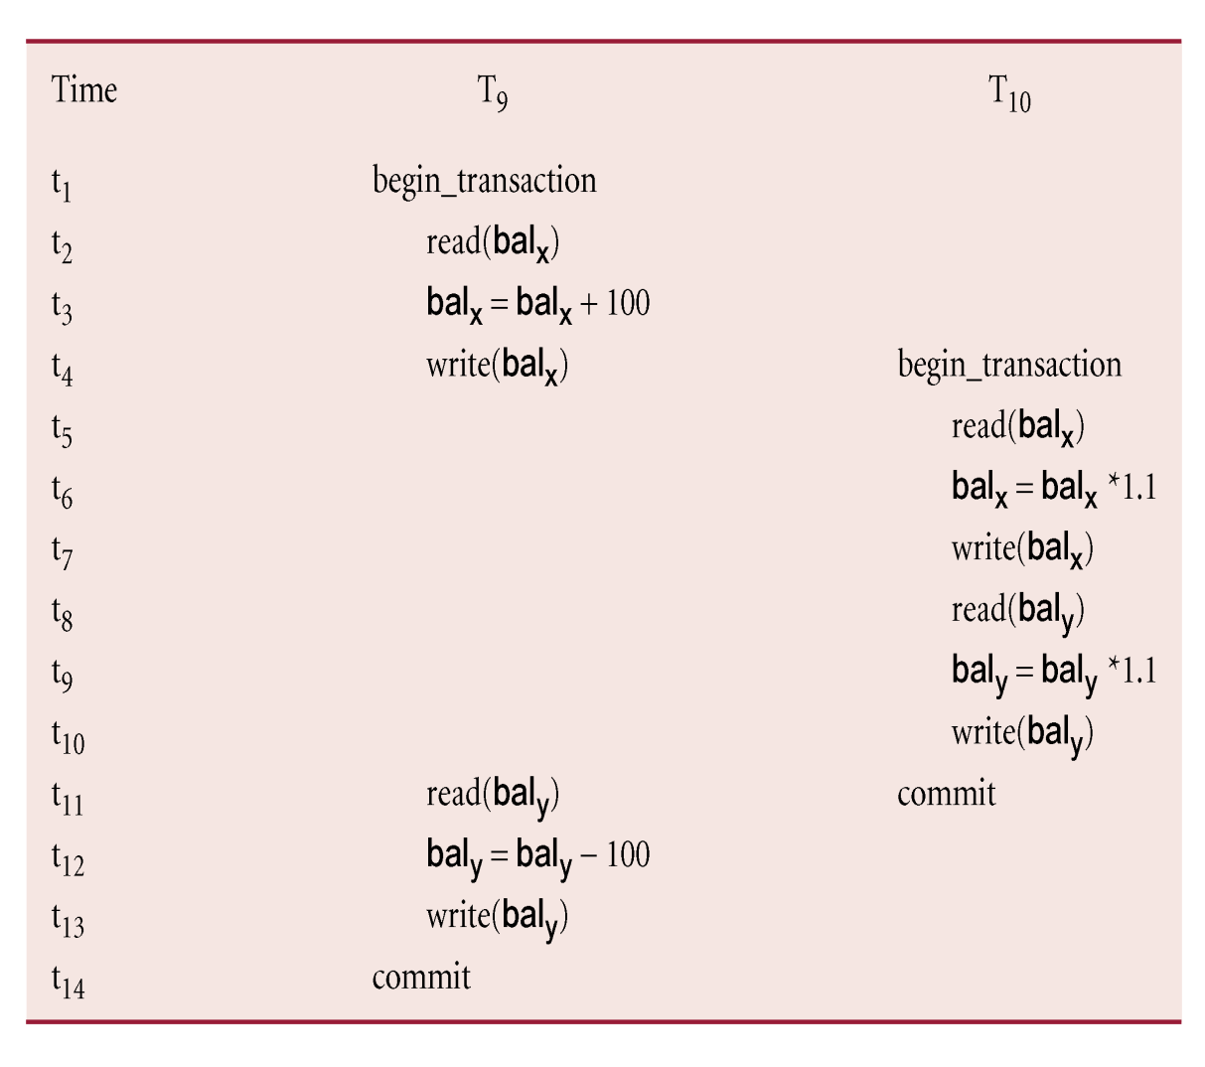
Example - Incorrect Locking Schedule
S = {write_lock(T₉, bal_{x}), read(T₉, bal_{x}), write(T₉, bal_{x}), unlock(T₉, bal_{x}), write_lock(T₁₀, bal_{x}), read(T₁₀, bal_{x}), write(T₁₀, bal_{x}), unlock(T₁₀, bal_{x}), write_lock(T₁₀, bal_{y}), read(T₁₀, bal_{y}), write(T₁₀, bal_{y}), unlock(T₁₀, bal_{y}), commit(T₁₀), write_lock(T₉, bal_{y}), read(T₉, bal_{y}), write(T₉, bal_{y}), unlock(T₉, bal_{y}), commit(T₉) }
‹#›

Slide 9
Example - Incorrect Locking Schedule
If at start, bal_{x} = 100, bal_{y} = 400, result should be:
bal_{x} = 220, bal_{y} = 330, if T₉ executes before T₁₀, or
bal_{x} = 210, bal_{y} = 340, if T₁₀ executes before T₉.
However, result gives bal_{x} = 220 & bal_{y} = 340.
S is not a serializable schedule.
‹#›

Slide 10
Example - Incorrect Locking Schedule
Problem - transactions release locks too soon, resulting in loss of total isolation and atomicity.
To guarantee serializability, need an additional protocol concerning the positioning of lock and unlock operations in every transaction.
‹#›

Slide 11
Two-Phase Locking (2PL)
Transaction follows 2PL protocol if all locking operations precede first unlock operation in the transaction.
Two phases for transaction:
Growing phase - acquires all locks but cannot release any locks.
Shrinking phase - releases locks but cannot acquire any new locks.
‹#›

Slide 12
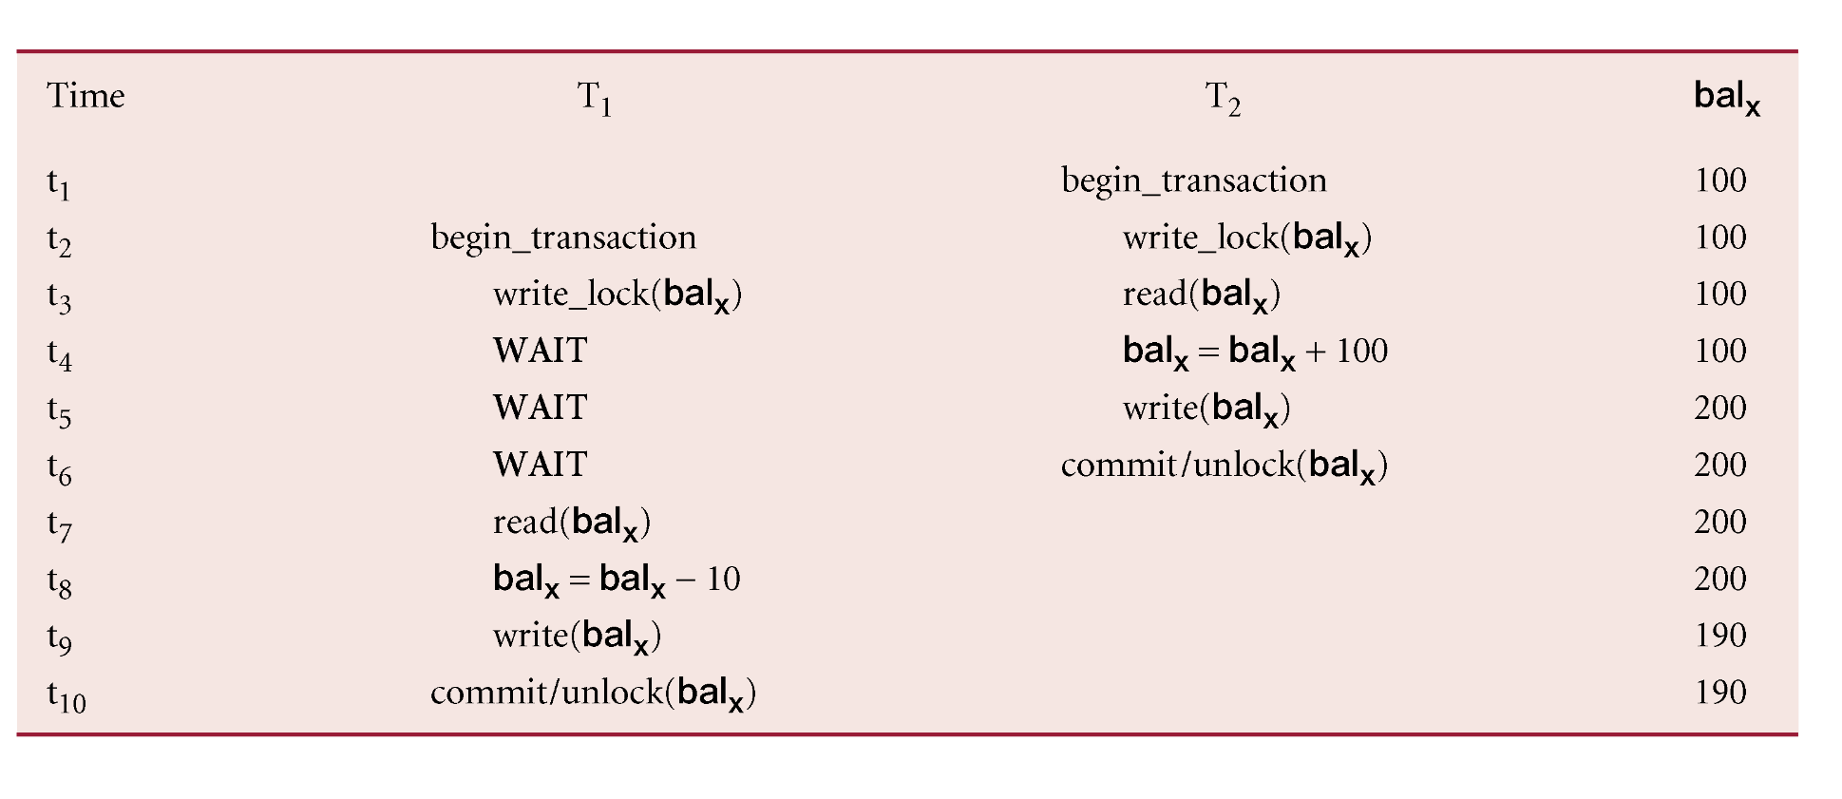
Preventing Lost Update Problem using 2PL
‹#›

Slide 13
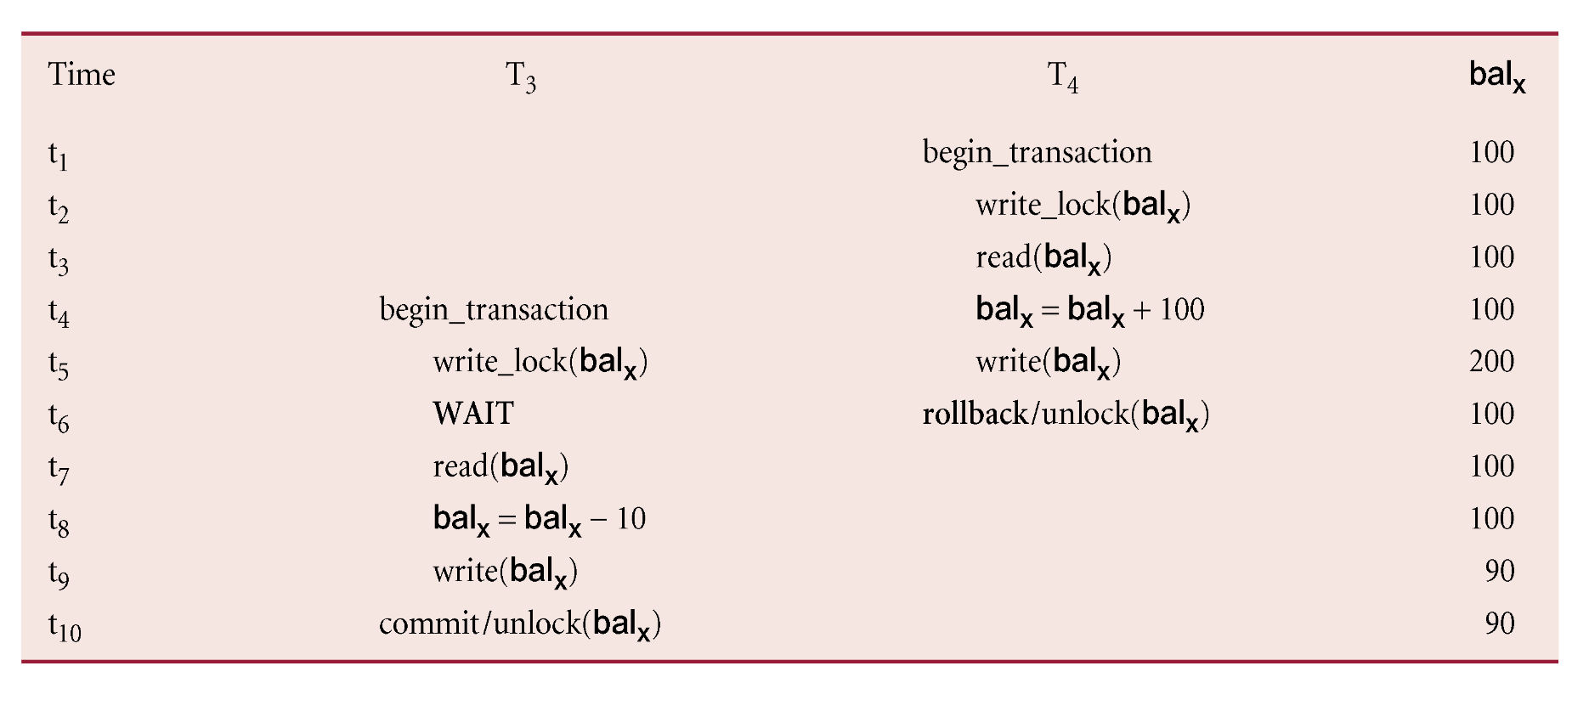
Preventing Uncommitted Dependency Problem using 2PL
‹#›

Slide 14
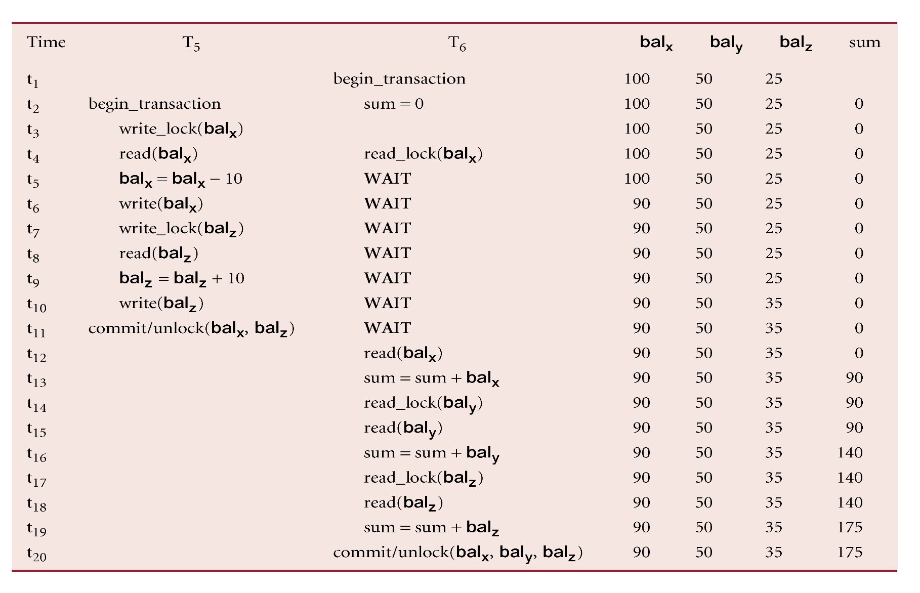
Preventing Inconsistent Analysis Problem using 2PL
‹#›

Slide 15
Cascading Rollback
If every transaction in a schedule follows 2PL, schedule is serializable.
However, problems can occur with interpretation of when locks can be released.
‹#›

Slide 16
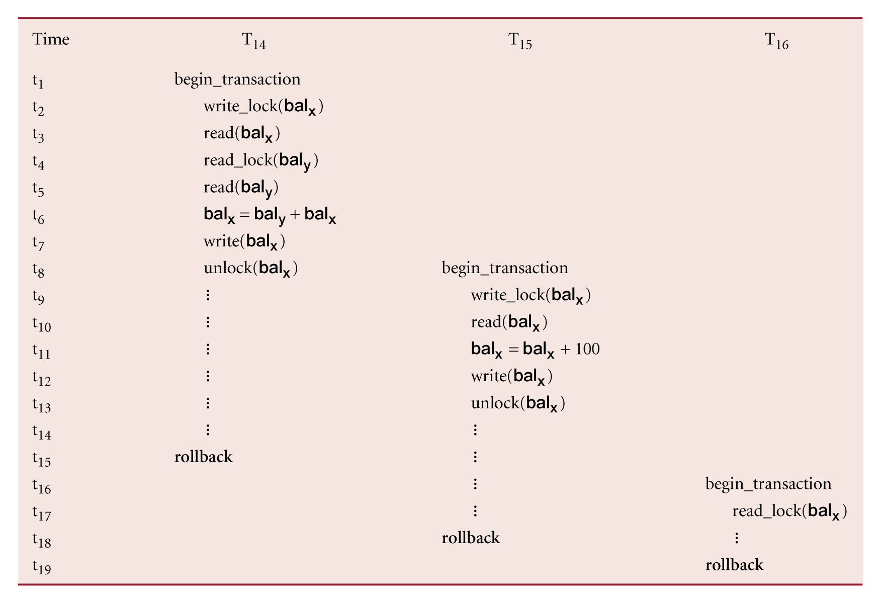
Cascading Rollback
‹#›

Slide 17
Cascading Rollback
Transactions conform to 2PL.
T₁₄ aborts.
Since T₁₅ is dependent on T₁₄, T₁₅ must also be rolled back. Since T₁₆ is dependent on T₁₅, it too must be rolled back.
This is called cascading rollback.
To prevent this with 2PL, leave release of all locks until end of transaction.
‹#›

Slide 18
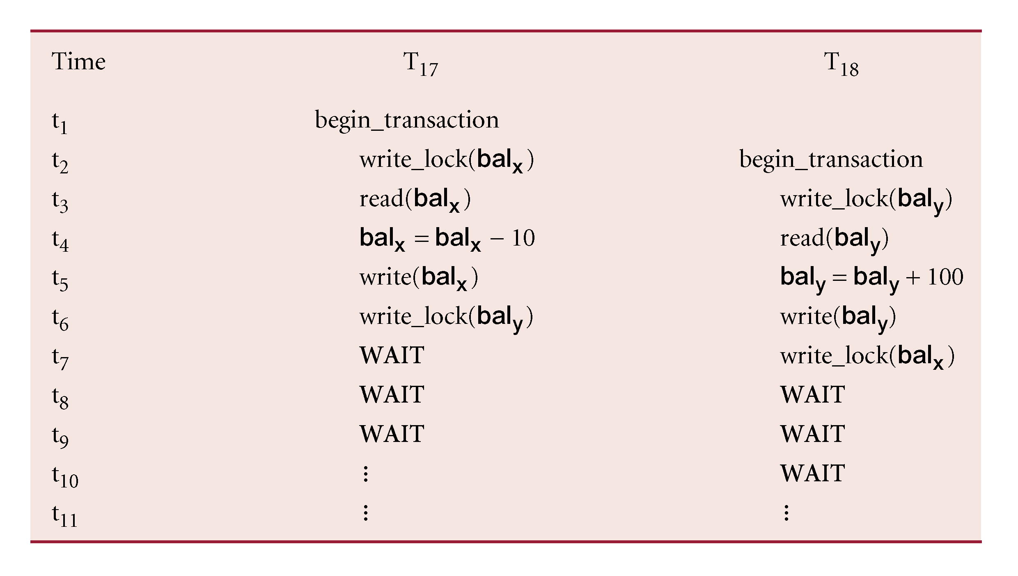
Deadlock
An impasse that may result when two (or more) transactions are each waiting for locks held by the other to be released.
‹#›

Slide 19
Deadlock
Only one way to break deadlock: abort one or more of the transactions.
Deadlock should be transparent to user, so DBMS should restart transaction(s).
However, in practice DBMS cannot restart aborted transaction since it is unaware of transaction logic even if it was aware of the transaction history (unless there is no user input in the transaction or the input is not a function of the database state).
‹#›

Slide 20
Deadlock
Three general techniques for handling deadlock:
Timeouts.
Deadlock prevention.
Deadlock detection and recovery.
‹#›

Slide 21
Timeouts
Transaction that requests lock will only wait for a system-defined period of time.
If lock has not been granted within this period, lock request times out.
In this case, DBMS assumes transaction may be deadlocked, even though it may not be, and it aborts and automatically restarts the transaction.
‹#›

Slide 22
Deadlock Prevention
DBMS looks ahead to see if transaction would cause deadlock and never allows deadlock to occur.
Could order transactions using transaction timestamps:
Wait-Die - only an older transaction can wait for younger one, otherwise transaction is aborted (dies) and restarted with same timestamp.
Wound-Wait - only a younger transaction can wait for an older one. If older transaction requests lock held by younger one, younger one is aborted (wounded).
‹#›

Slide 23
Deadlock Detection and Recovery
DBMS allows deadlock to occur but recognizes it and breaks it.
Usually handled by construction of wait-for graph (WFG) showing transaction dependencies:
Create a node for each transaction.
Create edge T_{i} -> T_{j}, if T_{i} waiting to lock item locked by T_{j}.
Deadlock exists if and only if WFG contains cycle.
WFG is created at regular intervals.
‹#›

Slide 24
Precedence Graph vs. WFG
Precedence graph
Each transaction is a vertex
Arcs from T1 to T2 if:
T1 reads X before T2 writes X
T1 writes X before T2 reads X
T1 writes X before T2 writes X
Wait-for Graph
Each transaction is a vertex
Arcs from T2 to T1 if:
T1 read-locks X then T2 tries to write-lock it
T1 write-locks X then T2 tries to read-lock it
T1 write-locks X then T2 tries to write-lock it

Slide 25
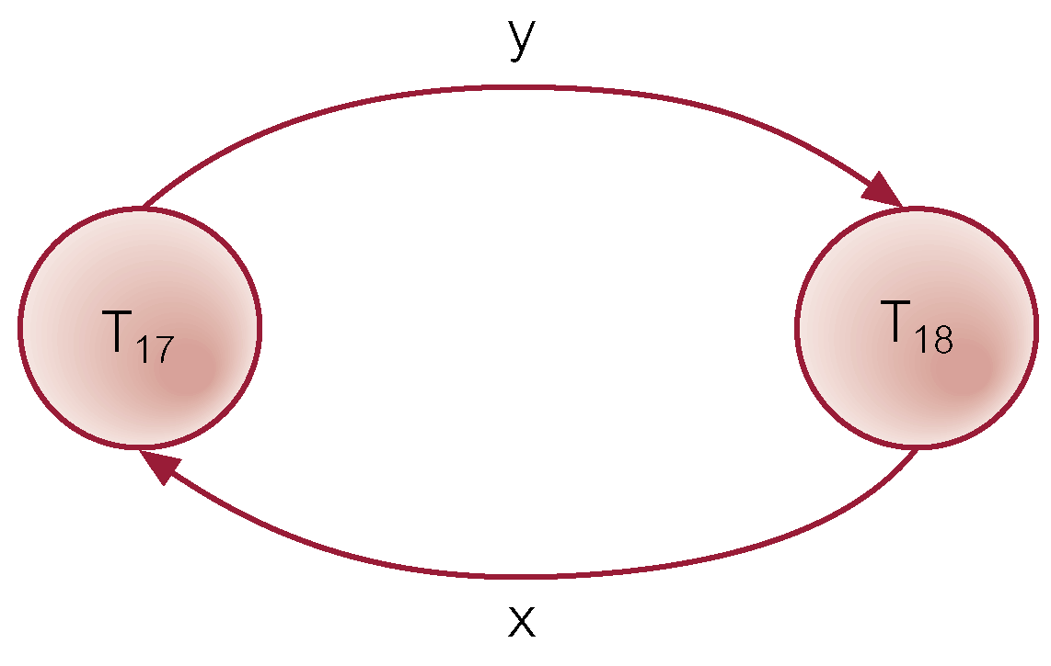
Example - Wait-For-Graph (WFG)
‹#›

Slide 26
Recovery from Deadlock Detection
Several issues:
choice of deadlock victim - abort transaction that incur the min costs
how far to roll a transaction back - may be possible to resolve deadlock by rolling back part of the transaction
avoiding starvation - Not always picking the same transaction as a victim (keep a count of number of time a transaction is selected)
‹#›

Slide 27
Concurrency Control Techniques
2- Timestamping
‹#›

Slide 28
Timestamping
Timestamp
A unique identifier created by DBMS that indicates relative starting time of a transaction.
Can be generated by using system clock at time transaction started, or by incrementing a logical counter every time a new transaction starts.
‹#›

Slide 29
Timestamping
Transactions ordered globally so that older transactions, transactions with smaller timestamps, get priority in the event of conflict.
Conflict is resolved by rolling back and restarting transaction. (No waiting involved like with Locks)
No locks so no deadlock.
‹#›

Slide 30
Timestamping
Timestamps for data items:
read-timestamp - timestamp of last transaction to read item;
write-timestamp - timestamp of last transaction to write item.
‹#›

Slide 31
Timestamping - Read(x)
Consider a transaction T with timestamp ts(T):
ts(T) < write_timestamp(x)
x already updated by younger (later) transaction.
Transaction must be aborted and restarted with a new timestamp.
‹#›

Slide 32
Timestamping - Write(x)
ts(T) < read_timestamp(x)
x already read by younger transaction.
Roll back transaction and restart it using a later timestamp.
ts(T) < write_timestamp(x)
x already written by younger transaction.
Write can safely be ignored - ignore obsolete write rule.
Otherwise, operation is accepted and executed.
‹#›

Slide 33
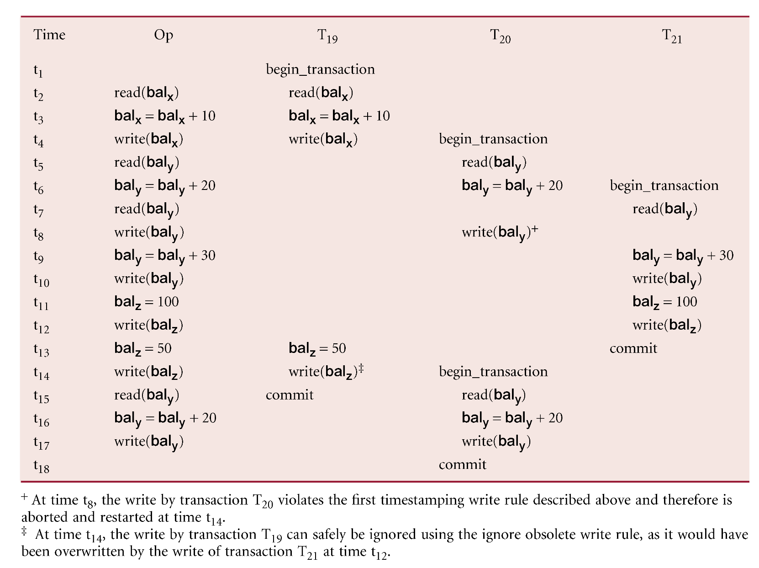
Example – Basic Timestamp Ordering
‹#›

